Slide 1

Thompson Sampling
Siddharth Ajit and Mason Rumuly
for ECEN 689-606

Slide 2
Outline
Multi-Arm Bandits
Exploration, Exploitation, and Regret
Bernoulli Distribution
The Beta Distribution and Modeling Uncertainty
Sampling Algorithm
Demo
Performance Guarantees
Variants

Slide 3
Multi-Arm Bandits
Royalty-free Picture of slot machines
Generally number of actions (or ‘arms’) with some probabilistic reward
Must take the action to learn about it
Objective: find arm with greatest expected value and use it
Mention some applications
Stationary distribution, 0-1 outcome. There are extensions to others, but are not necessary to understand fundamentals

Slide 4
Exploration, Exploitation, and Regret

Slide 5
Bernoulli Distribution

Slide 6

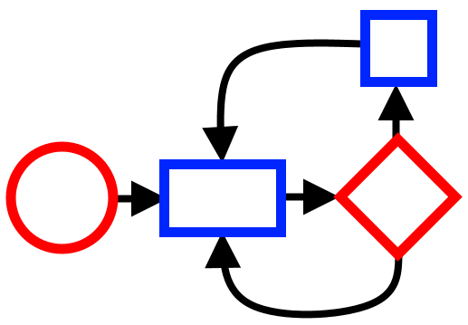
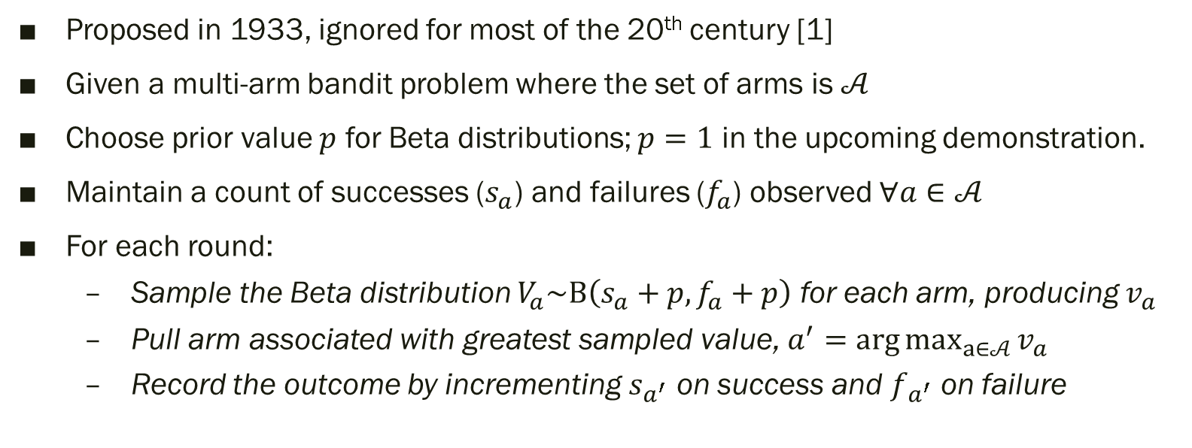
Sampling Algorithm
Proposed in 1933, ignored for most of the 20th century [1]
Given a multi-arm bandit problem where the set of arms is $𝒜$
Choose prior value $p$ for Beta distributions; $p=1$ in the upcoming demonstration.
Maintain a count of successes ($s_{a}$) and failures ($f_{a}$) observed $∀a∈𝒜$
For each round:
Sample the Beta distribution $V_{a}\sim Β\left(s_{a}+p,f_{a}+p\right)$ for each arm, producing $v_{a}$
Pull arm associated with greatest sampled value, $a^{′}=\arg{\max_{a∈𝒜}{v_{a}}}$
Record the outcome by incrementing $s_{a^{′}}$ on success and $f_{a^{′}}$ on failure

Slide 7

Demo
Open the associated IPython notebook for an interactive demonstration of Thompson Sampling

Slide 8


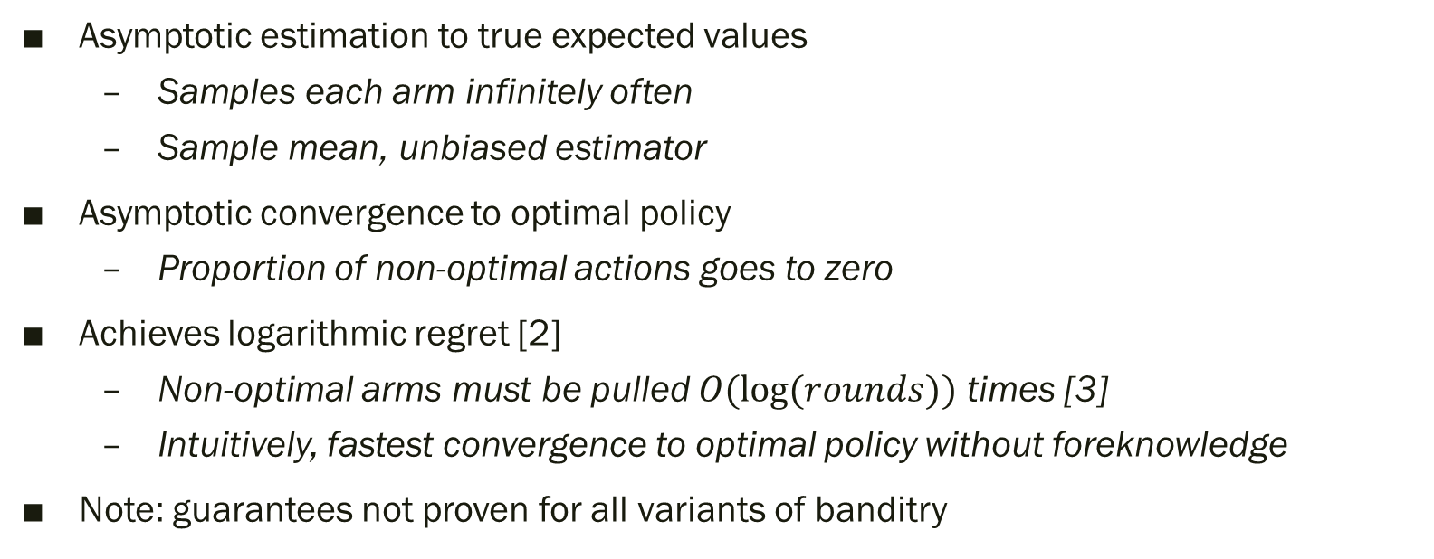
Performance Guarantees
Asymptotic estimation to true expected values
Samples each arm infinitely often
Sample mean, unbiased estimator
Asymptotic convergence to optimal policy
Proportion of non-optimal actions goes to zero
Achieves logarithmic regret [2]
Non-optimal arms must be pulled $O(log⁡(rounds))$ times [3]
Intuitively, fastest convergence to optimal policy without foreknowledge
Note: guarantees not proven for all variants of banditry

Slide 9
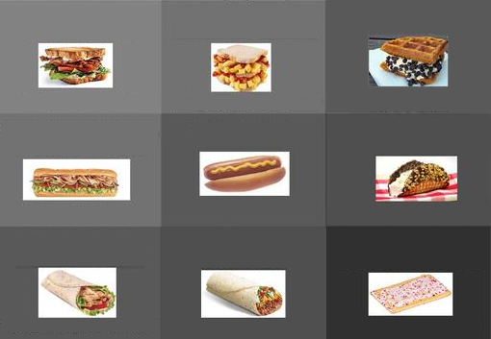
Variants
Keeping Counts
Number of samples & Mean
Number of samples & High Outcome
Choice of Beta prior parameters
Bayes (1,1), Uniform Distribution, safe bet
Haldane (0,0), All probability at edges, first-sample failure kills arm
Jeffrey (0.5, 0.5), Non-informative, risky for some bandits [4]
Choice of Prior Distribution for other Problems
Dirichlet for multi-outcome bandits
Gaussian for unbounded Real-Valued bandits
Non-stationary and Contextual Bandits, General RL Formulations

Slide 10
References
[1] Thompson, William R. "On the likelihood that one unknown probability exceeds another in view of the evidence of two samples". Biometrika, 25(3–4):285–294, 1933.
[2] Kaufmann, E., Korda, N., & Munos, R. “Thompson Sampling: an Asymptotically Optimal Finite-Time Analysis”. Proceedings of the 23rd international conference on Algorithmic Learning Theory (ALT’12) , pp. 199-213. 2012.
[3] Lai, T.L., & Robbins, H. “Asymptotically Efficient Adaptive Allocation Rules”. Advances in applied Mathematics, 6, pp 4-22, 1985.
[4] Junya Honda, Akimichi Takemura.“Optimality of Thompson Sampling for Gaussian Bandits Depends on Priors”. Proceedings of the Seventeenth International Conference on Artificial Intelligence and Statistics, PMLR 33:375-383, 2014.

